Slide 1

GE100 - Application of Information and Communication Technologies
Lec # 2: The Internet and the World Wide Web
Instructor: Alina Maryum

Slide 2
Learning Objectives
Discuss how the Internet evolved and what it is like today.
Identify the various types of individuals, companies, and organizations involved in the Internet community and explain their purposes.
Describe device and connection options for connecting to the Internet, as well as some considerations to keep in mind when selecting an ISP.
Understand how to search effectively for information on the Internet and how to cite Internet resources properly.
List several ways to communicate over the Internet, in addition to e-mail.
List several useful activities that can be performed via the Web.
Discuss censorship and privacy and how they are related to Internet use.
Notes:
Censorship refers to the suppression, restriction, or control of information, speech, or expression deemed inappropriate, harmful, or sensitive by governments, institutions, corporations, or other authorities.

Slide 3
Evolution of the Internet
Internet
Largest and most well-known computer network, linking millions of computers all over the world
The Internet has actually operated in one form or another for several decades
ARPANET
The predecessor of the Internet
Created in 1969 and named after the Advanced Research Projects Agency (ARPA), which sponsored its development
Initially connected four supercomputers; eventually evolved into today’s Internet
Notes:
Supercomputers are high-performance computing systems that are designed to perform extremely complex and large-scale computations at incredibly fast speeds, far beyond the capabilities of regular computers. They are used in fields that require immense computational power for tasks such as simulations, weather forecasting, climate research, scientific discovery, and advanced artificial intelligence.

Slide 4
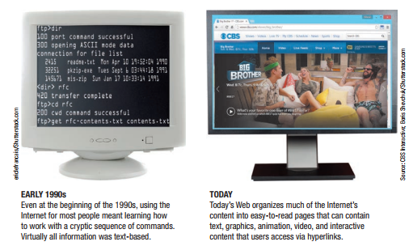
Evolution of the Internet
The World Wide Web
The collection of Web pages available through the Internet
Proposed by Tim Berners-Lee in 1989
Originally only text-based content; release of the Mosaic browser in 1993 led to graphical content

Slide 5
Evolution of the Internet
Web 2.0
Growing number of today’s Web-based applications and services
Wide variety of content available via Web pages today such as social networking, RSS feeds, podcasts, blogs and wikis
The World Wide Web and the Internet are not owned by any person, business, or organization
Primary infrastructure that makes up the Internet backbone is typically owned by communications companies
Notes:
RSS is a web feed format that allows users to receive real-time updates from websites, such as blogs, news, or podcasts, without having to manually visit the sites.
Podcasts are digital audio or video series available on the internet for download or streaming, usually episodic, often resembling radio shows but on-demand.
Blogs are regularly updated websites or online journals where individuals, organizations, or groups post content, typically in an informal or conversational style.
A wiki is a collaborative, web-based platform where multiple users can create, edit, and link content. It is often used for collective knowledge gathering and documentation.

Slide 6
Evolution of the Internet
Internet2
Consortium of researchers, educators, and technology leaders from industry, government, and the international community
Dedicated to the development of revolutionary Internet technologies
Research and development tool
Much of Internet2 is focused on speed

Slide 7

Evolution of the Internet
The Internet Community Today
Users
People who use the
Internet
Internet Service Providers (ISPs)
Provide access to the Internet, typically for a fee
Include most communication and media companies

Slide 8
Evolution of the Internet
Internet Content Providers
Persons or organizations that provide Internet content
Businesses, non-profit organizations, educational institutions, individuals
Application Service Providers (ASPs)
Companies that manage and distribute Web-based software services over the Internet
Cloud software, Software as a Service (SaaS), cloudware
Often fee-based business software

Slide 9
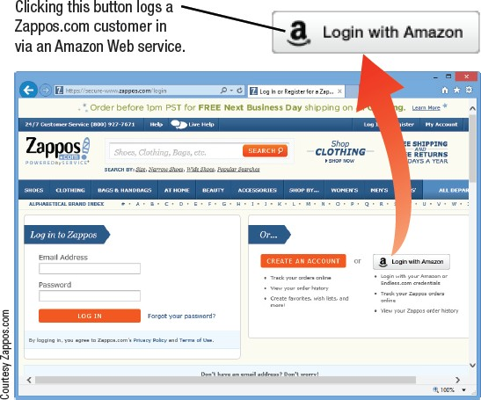
Evolution of the Internet
Web Services
Self-contained business application that operates over the Internet
Not stand-alone application
Standardized way of allowing Web-based applications to share data and work together
This Web service enables Web developers to use Amazon’s authentication system for users.

Slide 10
Evolution of the Internet
Infrastructure Companies
Enterprises that own or operating the physical structure of the Internet
Conventional and mobile phone companies, cable companies, and satellite Internet providers
Hardware and Software Companies
Provide the hardware and software used in conjunction
with the Internet and Web
Notes:
Infrastructure refers to the fundamental physical and organizational structures, systems, and services that support the functioning of a society, economy, or enterprise. It encompasses a wide range of facilities and systems that are essential for daily life, economic activities, and overall societal well-being.
Networks and systems that facilitate information exchange.

Slide 11
Evolution of the Internet
The Government and Other Organizations
Some countries limit information and access
FCC influences communications
Internet Society (ISOC)
Addresses issues impacting the future of the internet
Internet Corporation for Assigned Names and Numbers (ICANN)
Domain and IP management
World Wide Web Consortium (W3C)
Protocols and standards, ensures interoperability
Notes:
Interoperability refers to the ability of different systems, devices, applications, or components to work together and exchange information effectively, regardless of their underlying technologies or platforms.

Slide 12
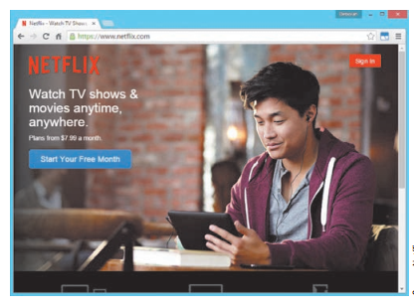
Myths About the Internet
Myth 1: The Internet is Free
Most people and businesses pay for Internet access
Businesses, schools, and libraries lease
communications lines from phone companies
Mobile phone users pay hotspot providers or mobile phone providers for access
Fee-based content is growing at a
rapid pace
Music/movie downloads
Donation-based sites

Slide 13
Myths About the Internet
Myth 2: Someone Controls the Internet
No single group or organization controls the Internet
Governments can regulate Internet use within its country,
but difficult to enforce
Myth 3: The Internet and World Wide Web are identical
Internet is the physical network
WWW is the collection of Web pages available over the
Internet
Other resources are available via the Internet, for example, FTP

Slide 14
Getting Set Up to Use the Internet
Involves three decisions
Determining the types of devices you will use to access the Internet
Deciding which type of connection is desired
Selecting the Internet service provider to be used
Once these determinations have been made, you can set up your Internet access and your devices

Slide 15
Type of Devices
Combination of factors to consider
Devices available to you
Whether you need access just at home or while on the go
What types of Internet content you want to access
Personal Computers
Smartphones, Media Tablets, and Other Mobile Devices
Gaming Devices and Televisions

Slide 16
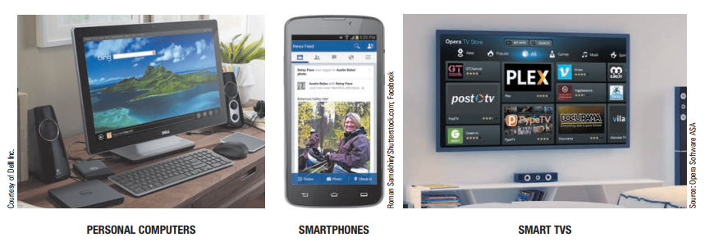
Types of Devices

Slide 17
Type of Connection and Internet Access
Computer must be connected to the Internet to obtain access
Most connections today are broadband
Dial-up vs. Direct Connections
Notes:
Broadband refers to high-speed internet access that is always on and faster than traditional dial-up access. It provides a wide bandwidth for transmitting data, enabling users to perform multiple online activities simultaneously, such as streaming videos, browsing the web, and using online applications, without significant delays or interruptions.

Slide 18
Type of Connection and Internet Access
Direct connections
Device is continually connected to the Internet
Access Internet using a browser—Internet Explorer, Chrome, or Firefox
Because you are always connected, it is important to protect your computer from hackers

Slide 19
Type of Connection and Internet Access
Conventional Dial-Up
Uses dial-up modem connected to standard telephone jack
Most often used with home computers for users who do
not need or do not want to pay for broadband
Inexpensive hardware
Easy to set up and use
Widespread availability
Slow connection speed

Slide 20
Type of Connection and Internet Access
Cable
Most widely used home broadband connection
Fast, typically around 25 Mbps
Requires a cable modem
DSL (Digital Subscriber Line)
Broadband delivered over telephone lines
Requires DSL modem
Must be less than 3 miles from a switching station
Transmits over telephone lines but does not tie up the line
Slower than cable speeds, typically 10 Mbps

Slide 21
Type of Connection and Internet Access
Satellite
Broadband option for rural areas
Slower and more expensive than cable or DSL
Requires satellite modem and transceiver dish the home or building to receive and transmit data to and from the satellites being used
Performance might degrade or stop altogether during bad weather

Slide 22
Type of Connection and Internet Access
Fixed Wireless
Uses radio transmission towers rather than satellites
Requires a modem and, sometimes, an outside-mounted transceiver
Uses Wi-Fi or WiMAX technology to broadcast
Speed between 2 Mbps and 10 Mbps
Notes:
A transceiver is a device that combines both a transmitter and a receiver into a single unit.

Slide 23
Type of Connection and Internet Access
Broadband over Fiber (BoF)
Delivers over fiber-optic cabling all the way to the building
Also called fiber-to-the-premises (FTTP)
Most often installed by telephone companies
Very fast up to 1 Gbps
Requires special networking equipment
Mobile Wireless
Access via a smartphone or media tablet
4G networks are often between 3 and 15 Mbps

Slide 24
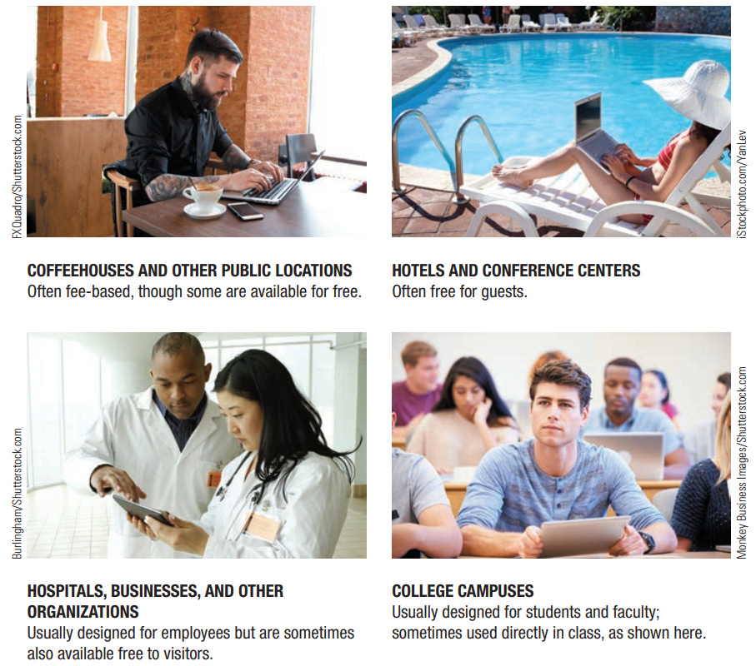
Type of Connection and Internet Access
Wi-Fi Hotspots
Public wireless networks (Wi-Fi)
Both free and fee-based are available

Slide 25
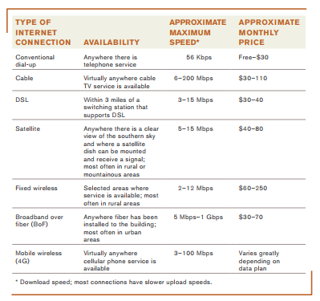
Type of Connection and Internet Access

Slide 26
Selecting an ISP and Setting Up Your Devices
Selecting an ISP
Type of device used, type of Internet connection, and service desired, geographic location will likely determine your ISP options
Questions to ask include services, speed, support, cost
Pricing options between different ISP companies will vary
Many ISPs offer tiers or different levels (speeds) of service for different prices

Slide 27
Selecting an ISP and Setting Up Your Devices
Setting Up Your Internet Connection and Devices
Install necessary hardware
Some may require professional installation, i.e.,
satellites and broadband over fiber
Select a user name and a payment method
Perform any necessary set-up to share the connection with other computers or devices

Slide 28
Searching the Internet
Search Sites
Websites designed to help users search for Web pages that match specified keywords or selected categories
Typically use a search engine in conjunction with a database containing information about Web pages to locate appropriate Web pages
Many search sites available (Google, Bing etc.)
Search site databases are updated on a regular basis
Typically, this occurs using small, automated programs (often called spiders or web crawlers) that use the hyperlinks located on Web pages to crawl (jump continually) from page to page

Slide 29
Searching the Internet
Keyword Search
Keywords are typed in a search box to locate information on the Internet
Matching Web pages are called hits
Clicking on a Web page name displays that page
Directory Search
Categories are selected to locate information on the Internet
Search Site Tools
Search for music files, image files, news articles, maps, people, videos
Google is one of the most versatile search sites

Slide 30
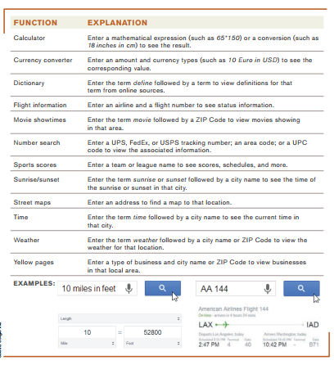
Searching the Internet

Slide 31
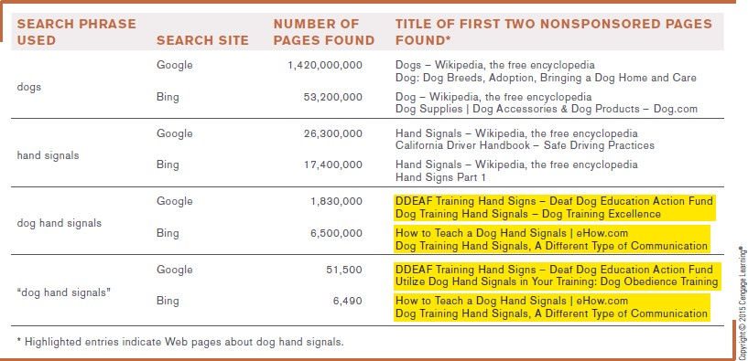
Search Strategies
Using Phrases
– Phrase searching is typing more than one keyword in a keyword search

Slide 32
Search Strategies
Using Search Operators
To further specify exactly what you want a search engine to find
Putting search phrase in quotation marks returns only pages with the same words in the same order as specified
Putting hyphen (or minus sign) before a word excludes that key term from the search
Using Multiple Search Sites
Different search sites can return different results

Slide 33
Search Strategies
Using Appropriate Keywords, Synonyms, Variant Word Forms, and Wildcards
When choosing the keywords to be used with a search site, it is important to select words that represent the key concept for searching
Synonyms are different words that mean the same thing
Variations of your keywords, alternate spellings, etc.
Wildcards, such as *, can be used to search for keyword patterns

Slide 34
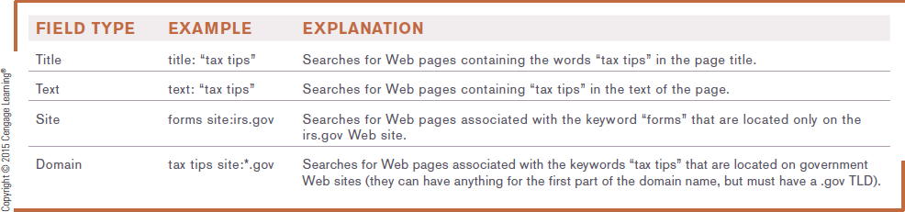
Search Strategies
Using Field Searches
– Field searches are searches limited to a particular characteristic, such as page title, page text, URL, top level domain or Web site

Slide 35
Evaluating Search Results
Does the title and listed description sound appropriate for the information you are seeking?
Is the URL from an appropriate company or organization?
You should also evaluate:
The author
The source
Determine if reliable or biased
The date
Many online articles are years old
Verify online information with a second source

Slide 36
Citing Internet Resources
To avoid plagiarism, proper citation procedures should be used for all Internet content used in a paper, book, or on a Web site
Citation should include:
Author
Date of publication
Article or Web page title
“Retrieved” statement listing the date the article was retrieved from the Internet and the URL used

Slide 37
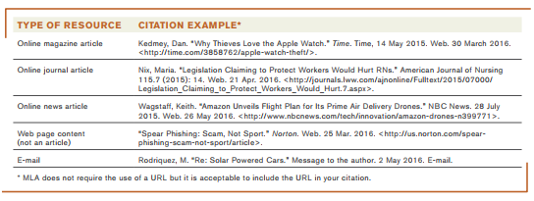
Citing Internet Resources

Slide 38
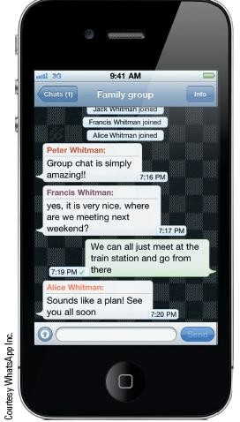
Beyond Browsing, Searching and E-Mail
Many types of other online communication methods exist
Instant Messaging (IM) and Text Messaging
Instant Messaging
Exchanging real-time messages
Example of presence technology
Text Messaging
Used by mobile phone users
Also called Short Message Service (SMS)
Beginning to replace e-mail with personal communication
Can be group messages

Slide 39
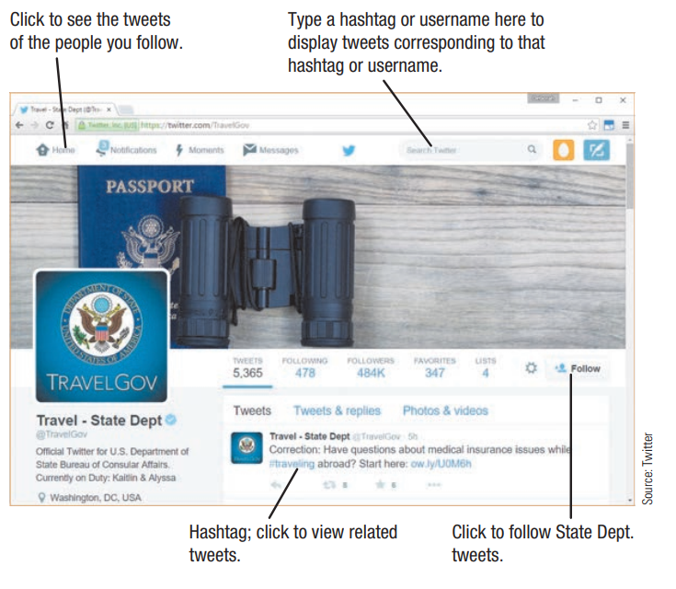
Beyond Browsing, Searching and E-Mail
Twittering and Social Networking Updates
Users post short updates called tweets
Used in both business and personal lives
Other types of status updates are available via some social networking sites

Slide 40
Beyond Browsing, Searching and E-Mail
Forums
Web page that enables individuals to post messages on a particular topic for others to read and respond to.
Voice over Internet Protocol (VoIP)
Making telephone calls over the Internet
Computer to computer
Skype, IM, etc.
More permanent VoIP setups replace landline phones
Relatively inexpensive—as little as $25 per month
Does not work when Internet connection or power is out

Slide 41
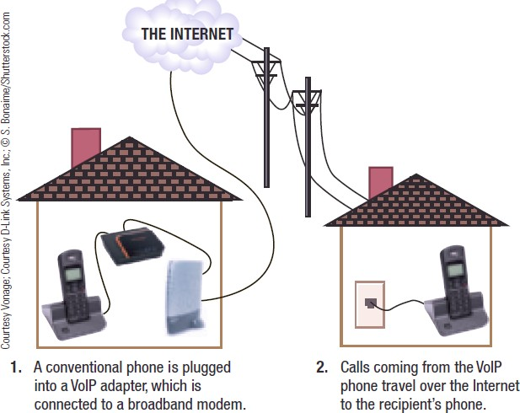
Beyond Browsing, Searching and E-Mail
Permanent VoIP setups allow telephone calls to be placed via a broadband Internet connection using a conventional telephone.

Slide 42
Beyond Browsing, Searching and E-Mail
Web Conferences and Webinars
Web Conference
Face-to-face meeting (video-conferencing) taking place via the Internet
Typically takes place using a personal computer or mobile phone
Used by individuals and businesses
Business Web conferencing is often used for meetings between individuals located in different geographical locations

Slide 43
Beyond Browsing, Searching and E-Mail
Webinar
A seminar presented via the Web
Webcast
A completely one-way presentation
Social Networking/Social Media
Social Networking Site
A site that enables a community of individuals to communicate and share information
Social Media
The collection of social networking sites and other communication channels used to share information

Slide 44
Beyond Browsing, Searching and E-Mail
Social Media Uses:
Share information about yourself (Facebook, etc.)
Connect people in specific geographic areas
Check in to locations
Sign in to Web sites
Business marketing tool
For security and safety reasons, users should be careful not to reveal too much about themselves
Sites are increasingly monitored by colleges and employers
– Carefully check what is posted and remove anything that might be potentially embarrassing

Slide 45
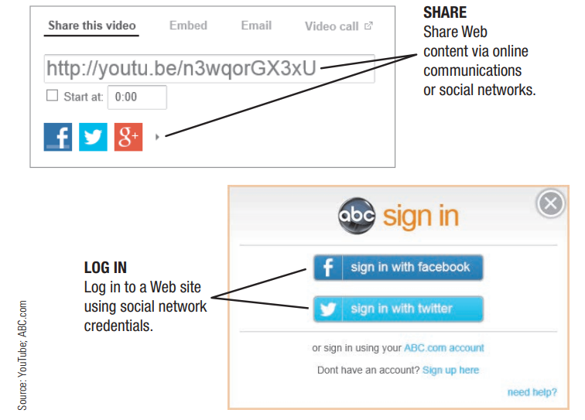
Beyond Browsing, Searching and E-Mail

Slide 46
Online Shopping and Investing
Online Shopping
Buying products or services over the Internet
Online Auction
Bids are placed for items and the highest bidder purchases the item
Online Banking
Performing banking activities via the Web
Online Investing
Buying and selling stocks or other types of investments via the Web

Slide 47
Online Entertainment
Online Music
Music played or obtained via the Web
Online TV, Videos, and Movies
Videos watched or downloaded via the Web
Live or recorded TV shows available via the Web
Feature films available via the Web
Video-on-demand (VoD) - Downloading movies and television shows, on-demand, via the Web
Internet Protocol Television (IPTV) – content delivered directly to your TV

Slide 48
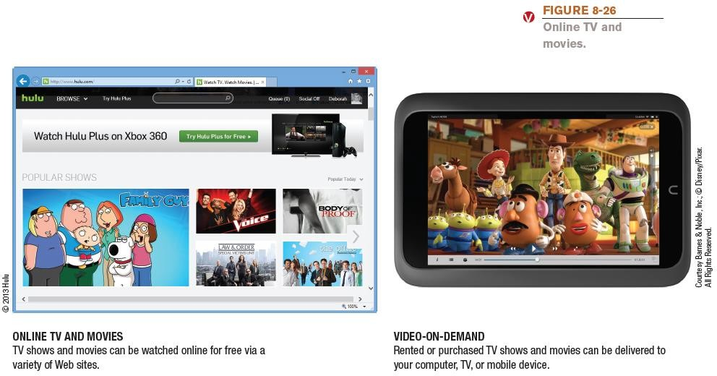
Online Entertainment

Slide 49
Online Entertainment
Online Gaming
Playing games via the Web
Web-based games, online multiplayer games, etc.
Quite often associated with Internet addiction
The inability to stop using the Internet or to prevent extensive use of the Internet from interfering with other aspects of one’s life
Gamification trend involves using gaming elements (earning points or rewards) in a non-entertainment context, such as for customer and employee engagement

Slide 50
Online News, Reference, and Information
Online News
Available through Web sites belonging to news organizations, television networks, newspapers, magazines, etc.
Usually updated on a continual basis
The growing trend is to abandon print subscriptions and provide Web-only service--mainly due to cost
News archives are often available (sometimes require a fee)

Slide 51
Online News, Reference, and Information
Reference Sites
Provide access to specific types of useful information
Check weather forecast,
Generate maps
Look up value of home
Provide access to encyclopedias, dictionaries, ZIP Code directories, and telephone directories
Potential downside use by criminals
RSS (Really Simple Syndication) Feeds
News tool that delivers selected Web content to subscribers as the content is published to a Web site

Slide 52
Online News, Reference, and Information
Product, Corporate, Government, and Other Information
Vast amount of product and government information available online
Product specifications
Instruction manuals
Tax forms
Government publications
Legislative bills
Wide variety of information from non-profit organizations, conservation groups, political parties, etc., also available

Slide 53
Online Education and Writing
Online Education
Using the Internet to facilitate learning
Web-based learning management systems
Used to deliver course content, manage assignments and grades, and more
Student response systems
Students use a special device or their mobile phone to respond to surveys or review questions during lectures

Slide 54
Online Education and Writing
Web-based training (WBT)
Refers to any instruction delivered via the Web.
Commonly used for employee training, as well as for delivering instruction in an educational setting
Distance Learning
Occurs whenever students take classes from a location that is different from the one where the delivery of instruction takes place
Online Testing
Taking tests via the Internet
Available for both objective and performance-based exams
Typically graded automatically
Cheating is an issue

Slide 55
Online Education and Writing
Online Writing
Blogs
A Web page that contains short, frequently updated entries in chronological order, typically by just one individual
Wikis
A collaborative Web page that is designed to be edited and republished by a variety of individuals
Wikipedia is one of the largest information repository
Carefully evaluate the content, as irresponsible individuals can enter erroneous information
E-portfolios
A collection of an individual’s work accessible via the Web

Slide 56
Censorship and Privacy Issues
Censorship
Some countries block some Internet content
To hinder the spread of information from the political opposition
To filter out material determined to be offensive
To protect national security
Some countries have attempted to regulate Internet content
Difficulty defining “patently offensive” and “indecent”
Difficult finding a fair balance between protection and censorship

Slide 57
Censorship and Privacy Issues
Internet Filtering
Using software or browser options to block access to particular Web pages or types of Web pages
Used by individuals, schools, employers, public computers, etc.
Can use browser settings or special filtering software
For computers and mobile devices

Slide 58
Censorship and Privacy Issues
Web Browsing Privacy
Encompasses what information about individuals is available, how it is used, and by whom
Cookies
Small files stored on a hard drive by a Web server
Used to identify return visitors and their preferences
Can be used to track Web activity
Can be personally or non-personally identifiable
Data can be viewed or deleted
Settings can be changed; can be managed with software

Slide 59
Censorship and Privacy Issues
Spyware and Adware
Spyware
Software installed without users knowledge that transmits data secretly through the user’s Internet connection
Sometimes used by advertisers to gather marketing information
Used by criminals to gather personal data stored on your computer

Slide 60
Censorship and Privacy Issues
Adware
Software supported by onscreen advertising
Often included in free programs
Does not gather information
Is not installed without user’s consent
E-Mail Privacy
Only encrypted e-mail can be transmitted privately
Employers and ISPs have access to e-mails sent through those organizations
Businesses and ISPs typically archive e-mail messages

Slide 61
Summary
Evolution of the Internet
Getting Set Up to Use the Internet
Searching the Internet
Beyond Browsing and E-Mail
Censorship and Privacy Issues

